Slide 1
Domain Driven Design
Diane Wilson
FujiFilm Medical Systems

Slide 2
Domain Driven Design
Part 2: Strategic Design and Architecture

Slide 3
Assumptions
We’re all experienced professionals
Enterprise applications
.NET centric?
Relational database centric?
Domain Driven Design can enhance our current processes
We can learn from each other
You can catch up if you missed last month

Slide 4
Domain Driven Design
Tackling Complexity in real world, complex systems
Business experts and developers on one team
Ubiquitous language
Design using domain model

Slide 5
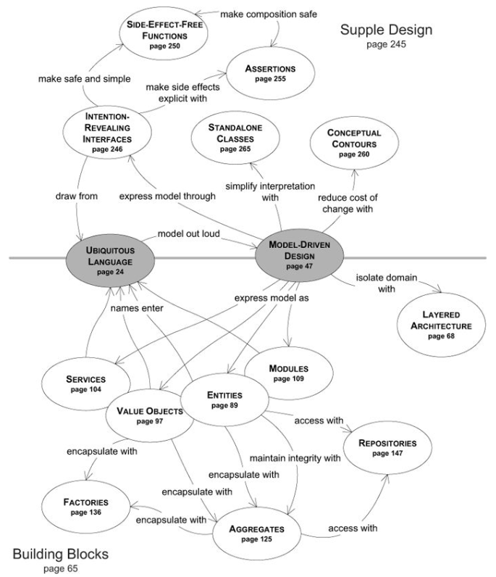
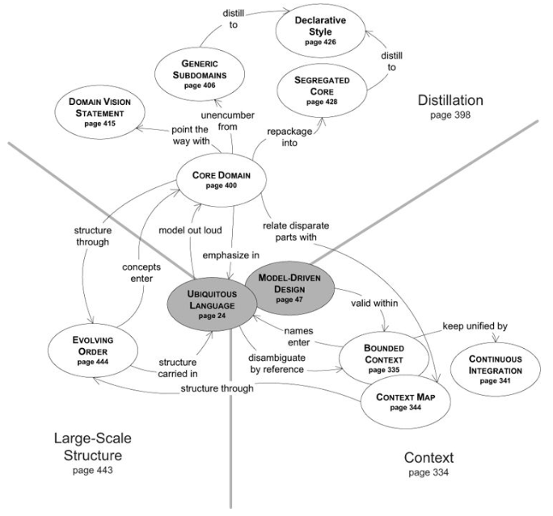

Slide 6
Domain Language
Example: “OPEN reversal of cartel controls, Saudi Arabia swing producer – inc or dec supply to control price. Chicken with shale producers. Don’t want to cede market share in Asia”
This is the language of someone’s domain
Who needs to understand it?

Slide 7
Ubiquitous Language
“Each resource within the RIS would have a field to assign a weighting factor for the dose information provided by that modality/equipment. The field would allow for calculation of a common factor for exposure to the patient regardless of manufacturer. In most cases this would be a simple multiplier, but in some cases would require more complex calculations. The intent is to provide a field for a physicist to add a consistent calculation that would be applied to all results received from a particular machine to normalize the data. Additional display values would also be optional to show per resource including adding the display value for CTDI, DLP, Organ Dose, Whole Body exposure, or other.”
This is the language of MY DOMAIN
One Team, One Language

Slide 8
Single Domain Model for Analysis and Design
Based on Ubiquitous Language
Names, Events, Relationships
Requires attention to style and self-discipline
Must do the right thing, and say the right thing
One model underlies implementation, design, team communication
The model and the design shape each other
Correspondence between model and design must be literal and exact

Slide 9
Domain Driven Design Patterns
Strategic Patterns
Domain
Core domain
Subdomain
Generic subdomain
Bounded context
Context map
Tactical Patterns
Value objects
(Domain) Entities
(Domain) Services
(Domain) Events
Modules
Aggregates

Slide 10
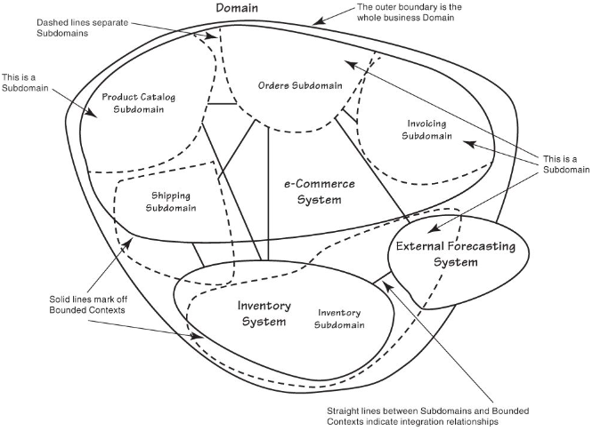
The Big Picture
Domain patterns overlaid on a typical system
Overlapping responsibilities
Unclear communications
Overlapping models

Slide 11
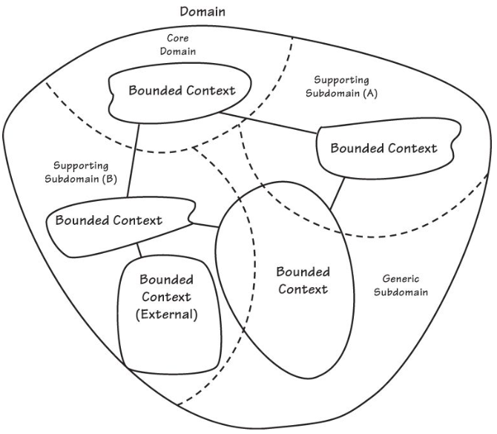
Abstract Domains and Contexts
Relationships
Domain to Core Domain
Core Domain to Subdomains
Bounded Contexts to Subdomains
What is a generic subdomain?
What is the scope of a Bounded Context?

Slide 12
Domains and Bounded Contexts
Whiteboard Time
List your subdomains and bounded contexts
Fit those to the abstract model
Create your own model to fit your subdomains and bounded contexts
Separate out supporting subdomains and generic subdomains

Slide 13
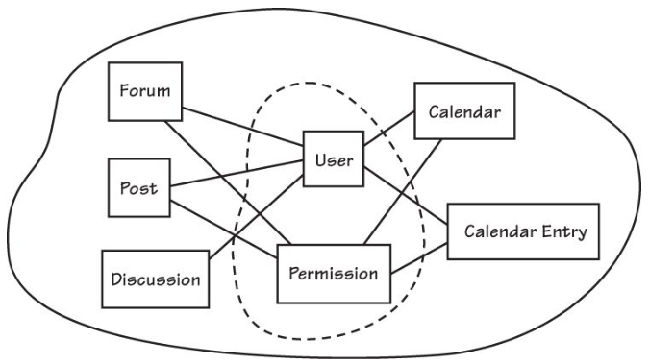
Example: Collaboration Project
First try: The Big Ball of Mud
What doesn’t fit here?

Slide 14
Strategic Design
Whiteboard time
What is the name and vision for your strategic Core Domain?
What concepts should be part of your Core Domain
What are the necessary supporting subdomains and generic subdomains?
What is your problem space?
Core Domain
Supporting Subdomains

Slide 15
Strategic Questions
What software assets exist? Can they be reused?
What needs to be created?
How do these connect and integrate?
Where are the terms of the Ubiquitous Languages completely different?
Where is the overlap and sharing of concepts and data between Bounded Contexts?
How are shared terms and overlapping concepts mapped and translated between Bounded Contexts?

Slide 16
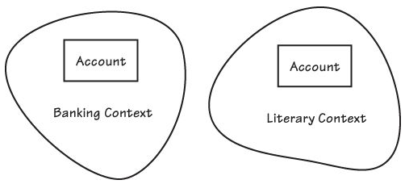
Making Sense of Bounded Contexts
Bounded Context is Explicit and Linguistic
Context is everything
Whiteboard time
Identify the bounded contexts in your project
Identify subtly different concepts between multiple bounded contexts in your domain
Decide whether these concepts are properly separated, or if they can be reused
Can you imagine other components in those contexts?
Where are the user interfaces, services, schemas, and persistence stores?

Slide 17
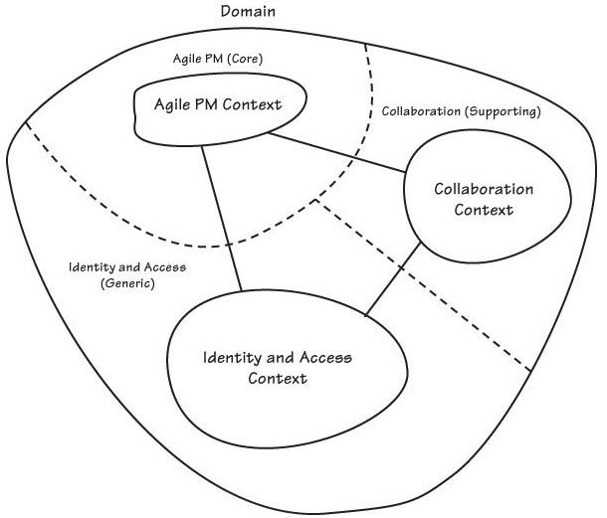
Sample Domain

Slide 18
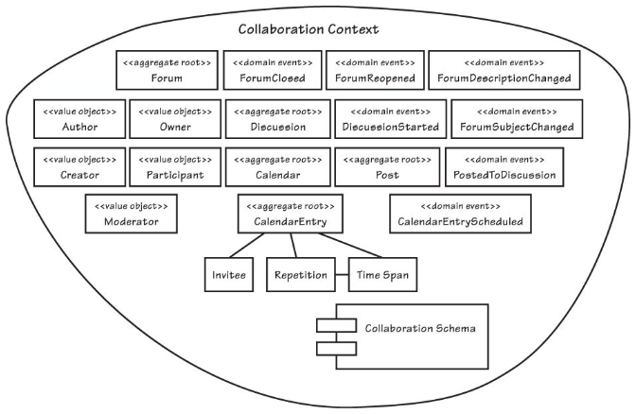
Sample Context

Slide 19
What Went Wrong
Proceeding directly to code…
Context accesses users directly
Context accesses repository directly
Permission-based rather than role-based
This leads to architectural issues…
Identity, permissions, and roles belong in a generic subdomain
Repository is infrastructure, not part of the domain

Slide 20
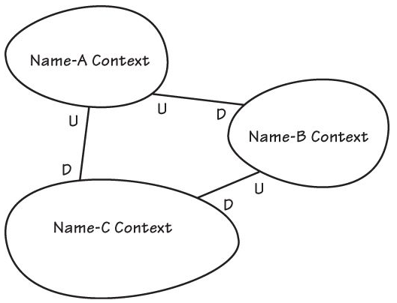
Context Maps
How do Bounded Contexts Communicate?
Whiteboard time
Draw a diagram of your current project, with boundaries and relationships
NOTE: A Context Map is not an Enterprise Architecture or system topology

Slide 21
Relationships Between Bounded Contexts
Partnership – Two contexts succeed or fail together, and cooperate
Shared Kernel – Code sharing between contexts, with interfaces tightly defined by the Ubiquitous Languages of each context
Customer-Supplier – Upstream team can succeed without the downstream context
Anticorruption Layer – Translation boundary, especially when cooperation or collaboration is not possible
Open Host Service – Open, published protocol as a set of services
Published Language – Translation between two contexts based on a published, well-documented, shared language, often combined with Open Host Service
Separate Ways – No significant relationship
Big Ball of Mud – Mixed models and inconsistent boundaries

Slide 22
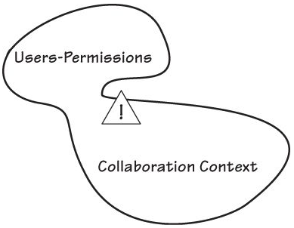
Context Map Evolution
Step One – Big Ball of Mud

Slide 23
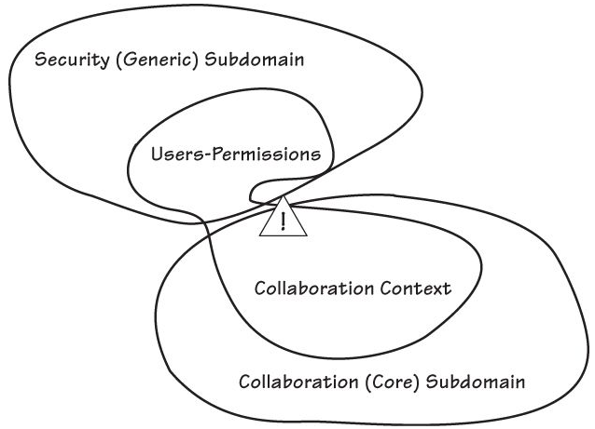
Context Map Evolution
Step Two – Big Ball of Mud, contained within a Bounded Context

Slide 24
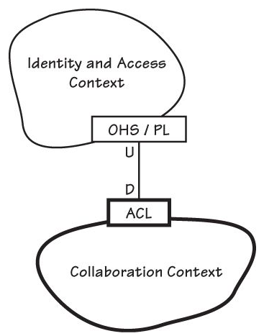
Context Map Evolution
Step Three
Fully separated bounded contexts
Identity and Access becomes a Bounded Context within a generic subdomain
Open Host Service
Published Language
Collaboration Context
Anticorruption Layer translates Identity and Access into Roles and Permissions

Slide 25
Bounded Contexts and Context Maps
Whiteboard time
Within your own bounded contexts, can you identify concepts that don’t belong?
Draw a new Context Map
Which integration relationships would you choose, and why?

Slide 26
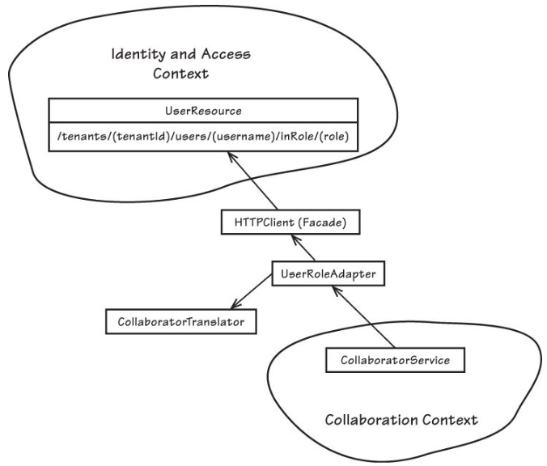
Context Map Evolution
Step Four
Service and Translation, refined

Slide 27
Architecture
Isolate the domain architecture from the rest of the application
Domain Driven Design does not dictate architecture

Slide 28
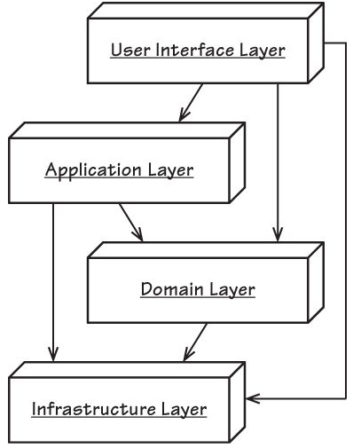
Architecture: Layers

Slide 29
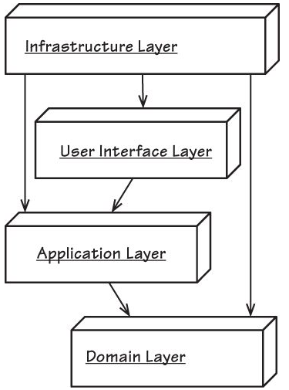
Architecture: Dependency Injection

Slide 30
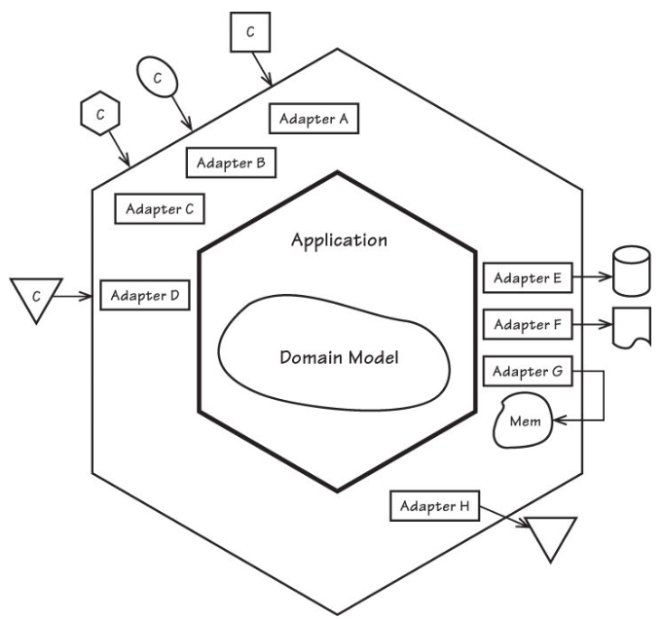
Architecture: Hexagonal
Also known as Ports and Adapters

Slide 31
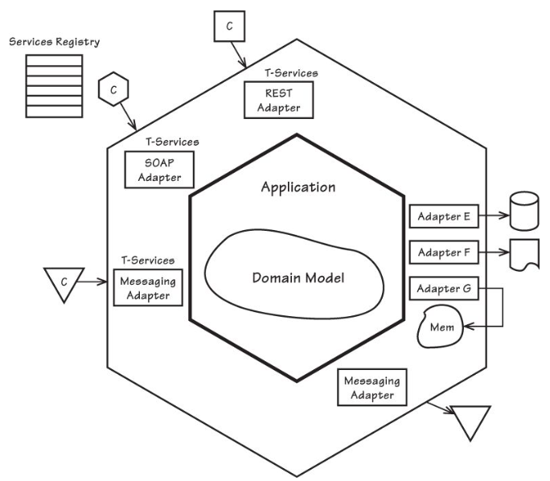
Architecture: Service-Oriented

Slide 32
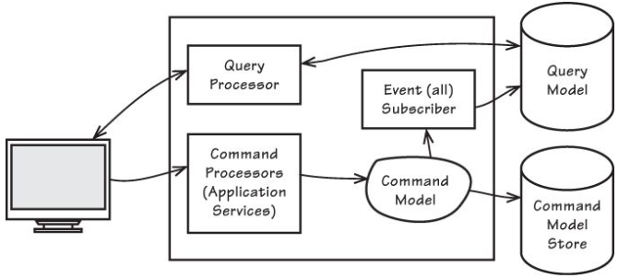
Architecture: CQRS
Command-Query Responsibility Separation

Slide 33
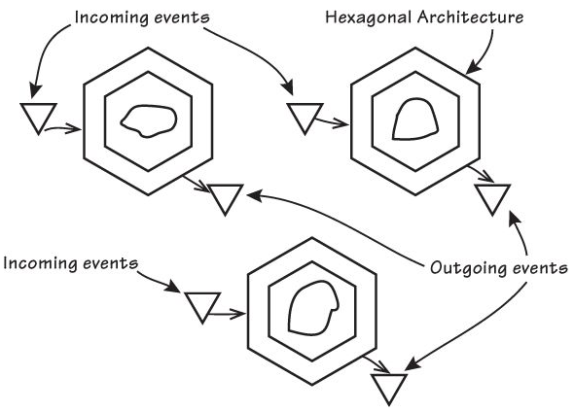
Architecture: Event-Driven

Slide 34
Other Architectures
Event-Driven with Long-running Processes
Event Sourcing
Data Fabric and Grid-Based Distributed Computing

Slide 35
Next Month
Domain Driven Design Patterns – Tactical Design

Slide 36
Resources
Implementing Domain-Driven Design (Vaughn Vernon)
Diane Wilson
dianewilson@outlook.com
@dianewilsonnc

